Slide 1
Protein structure prediction based on fragment assembly and parameter optimization
Julian Lee, Seung-Yeon Kim, Jooyoung Lee
Biophysical Chemistry 115 (2005) 209– 214
Speaker: Chun-Jen Chen
Date: July 14, 2009

Slide 2
Abstract
We propose a novel method for ab-initio prediction of protein tertiary structures based on the fragment assembly and global optimization. Fifteen residue long fragment libraries are constructed using the secondary structure prediction method PREDICT, and fragments in these libraries are assembled to generate full-length chains of a query protein. Tertiary structures of 50 to 100 conformations are obtained by minimizing an energy function for proteins, using the conformational space annealing method that enables one to sample diverse low-lying local minima of the energy.
115/11/08

Slide 3
Abstract
Then in order to enhance the performance of the prediction method, we optimize the linear parameters of the energy function, so that the native-like conformations become energetically more favorable than the non-native ones for proteins with known structures. We test the feasibility of the parameter optimization procedure by applying it to the training set consisting of three proteins: the 10–55 residue fragment of staphylococcal protein A (PDB ID 1bdd), a designed protein betanova, and 1fsd.
115/11/08

Slide 4
Fragment assembly
The fragment libraries used in PROFESY(PROFile Enumerating SYstem), are constructed using the recently proposed secondary structure prediction method PREDICT (PRofile Enumeration DICTionary) [27,28].

Slide 5
Fragment assembly
For each residue of a query sequence, a window of size fifteen is considered, where the center of the window is located on the residue under consideration. The fragment library of this residue is the collection of twenty backbone structures of the corresponding twenty nearest patterns in the pattern database of PREDICT.
After constructing fragment libraries for all residues of a query sequence, full-length chain conformations can be constructed by assembling fragments in these libraries.

Slide 6
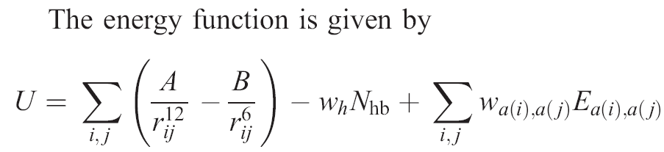
The first term is the Lennard–Jones 6–12 Van der Waals energy introduced to avoid steric clashes.
In the second term, N_{hb} is the number of hydrogen bonds between residues, which are at least five residues apart in sequence.

Slide 7
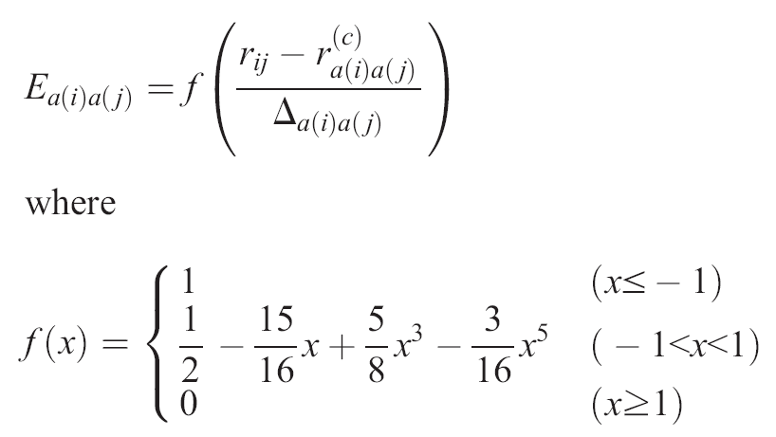
The last term is a Miyazawa–Jernigan type contact term [39,40]

Slide 8
Local minimization
In PROFESY, a conformation generated from a fragment assembly is locally minimized with respect to the energy by randomly selecting a residue and attempting to replace a part of the fifteen residue long fragment of the chain by another one in the corresponding library. If the new fragment can be inserted smoothly into the existing chain and if the new conformation is lower in energy than the existing one, the former replaces the latter.

Slide 9
Conformational sampling
The CSA (conformational space annealing) [29–31] is a powerful global optimization algorithm that has played the integral role in the recent success of the energy-based method for protein structure prediction

Slide 10
Conformational sampling
A population of local minimum-energy conformations is maintained in the CSA method, which is called the bank. The diversity of the bank is directly controlled in CSA by introducing a distance measure D(A,B) between two conformations A and B, and comparing it to a cutoff value, D_{cut}.

Slide 11

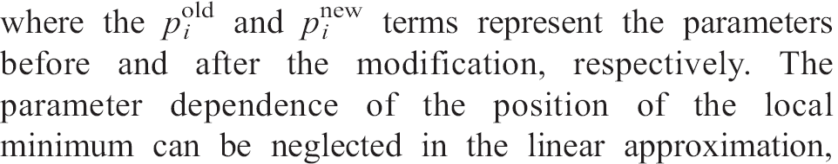
Parameter refinement using linear programming

Slide 12
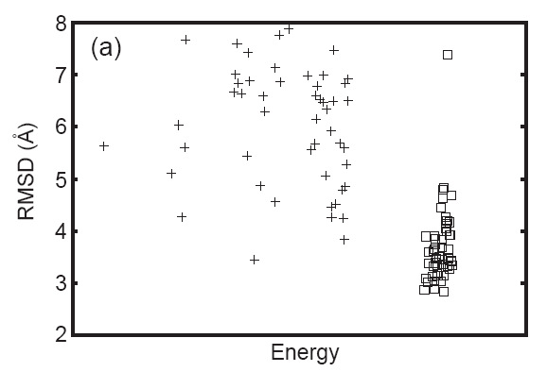

Slide 13
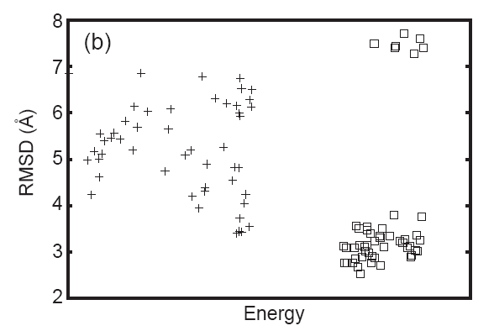

Slide 14
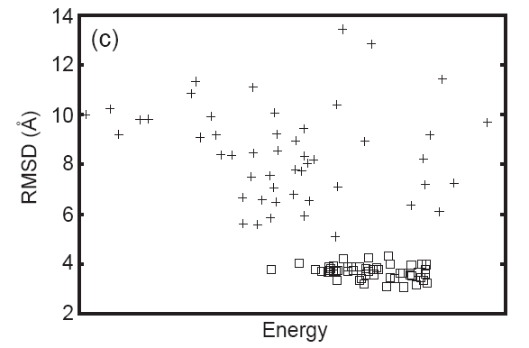

Slide 15
Fifty conformations were sampled in each CSA search, and the global minimum-energy conformations (GMECs) found with the initial parameters have RMSD values of 5.6, 6.9, and 10.0 Å, respectively, and the smallest values of RMSD found from the CSA search are 3.4, 3.4 and 5.1 Å, respectively.

Slide 16
After the 27-th iteration of the parameter refinement, the conformations with smaller values of RMSD are found from the global CSA search. The GMECs have RMSD values of 2.9, 3.1, and 3.8 Å and the smallest values of RMSD found are 2.8, 2.5, and 3.1 Å, respectively.

Slide 17
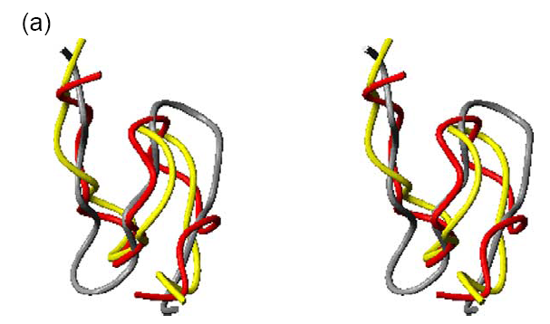

Slide 18
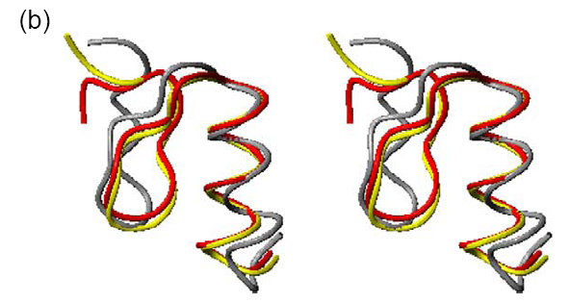

Slide 19
